Slide 1
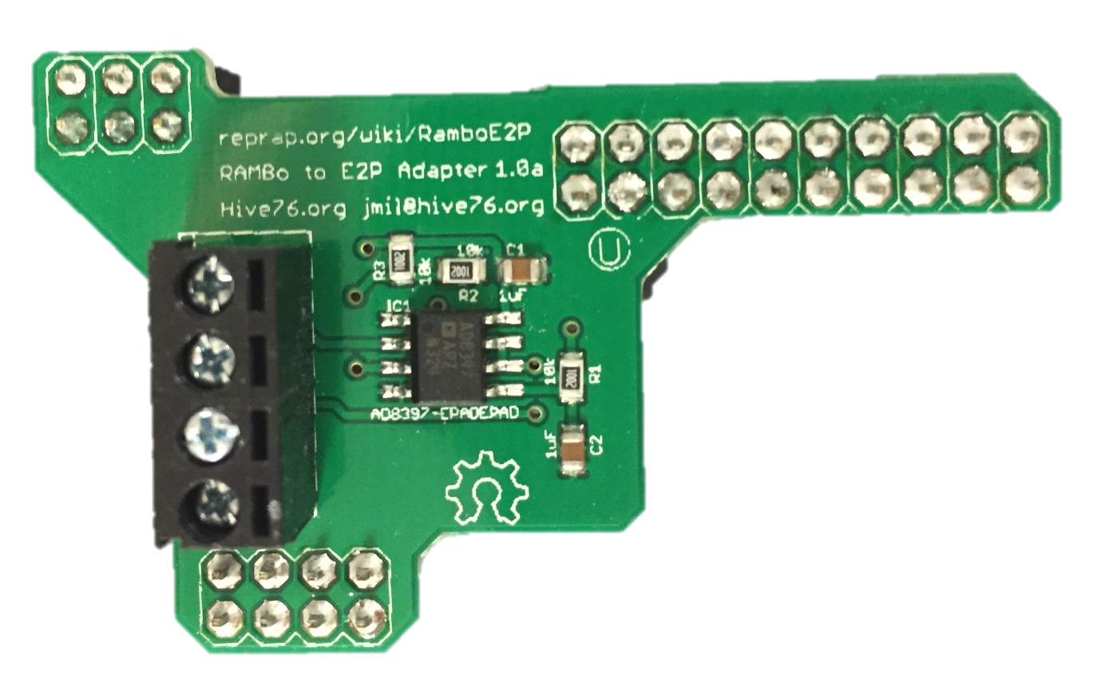
USB Connection to PC
Electro-pneumatic transducer
Solenoid Valve
RAMBo v1.2
Optional heated bed
+ - + - + -
Pressure thingy
Input power: 12V DC; 30A

